Slide 1
Operating system
Review: OS’s big picture now

Slide 2
Review
Sketch of OS
Infinite repetition, 4 components, services for others
Understand the execution first
CPU and controller as special chips which could understand and execute the instructions (together with other parameters)
2 mappings share similar scheme
from logic file space (a finite collection of bytes) into linear addressed space (frames, blocks)

Slide 3
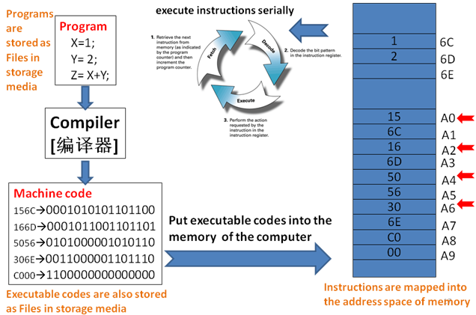
The power of computer systems
To execute programs!

Slide 4
Definition of OS
The software/program which contains a collection of many routines (functions, programs) to support the automatic execution of many cooperated and concurrent programs
Many subtasks should be considered
EMM
Execution: how is your program run?
Mapping 2: locate the program files (instructions and data) in Hdisk
Mapping 1: copy the selected program files (instructions and data) from Hdisk into appropriate regions in MM
GSD: GUI, Security, Distributed

Slide 5
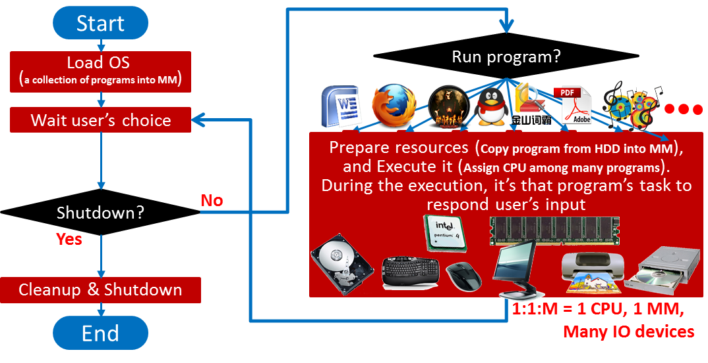
Helpful diagram to understand OS
Infinite repetition controlled by users

Slide 6
The roles of OS
Friendly interface for the users
Files, GUI
Efficient and safe manager for the resources
Storage media
I/O devices
Memory
CPU
User₁
User₂
User₃
User_{n}
Compiler Assembler Text editor … DBMS
System & application programs
Operating system
Computer hardware
Notes:
The hardware—the central processing unit (CPU), the memory, and the input/output (I/O) devices—provides the basic computing resources for the system.
The application programs—such as word processors, spreadsheets, compilers, and Web browsers—define the ways in which these resources are used to solve users’ computing problems.
The operating system controls the hardware and coordinates its use among the various application programs for the various users.

Slide 7
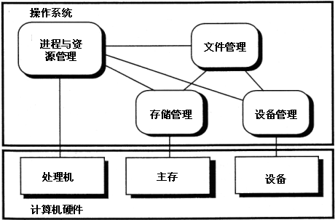
Four fundamental components of modern OS
Operating System
Process Management
File
Management
Memory
Management
Device
Management
CPU
Main Memory
IO Devices
Hardwares

Slide 8
ALU
CPU
CU
Hardware
Memory
I/O
Computer
System
OS
Utilities
Drivers
…
System
software
Software
Document
Spreadsheet
Database Software
Graphics
…
Application
software
Notes:
The Von-Neumann architecture is an architecture for constructing actual computers (which implement what the Turing machine describes theoretically).

Slide 9
Review
Sketch of OS
Infinite repetition, 4 components, services for others
Understand the execution first
CPU and controller as special chips which could understand and execute the instructions (together with other parameters)
2 mappings share similar scheme
from logic file space (a finite collection of bytes) into linear addressed space (frames, blocks)

Slide 10
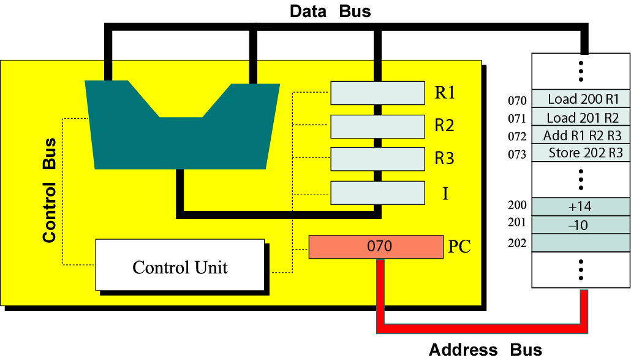
Device Controller Interface
busy done
0 0 idle
0 1 finished
1 0 working
1 1 (undefined)
. . .
busy
done
Error code
. . .
Command
Status
Data 0
Data 1
Logic
Data n-1
In fact, there should be ``status’’ register in CPU too
PPTs from others\cms.dt.uh.edu\chap04.ppt

Slide 11
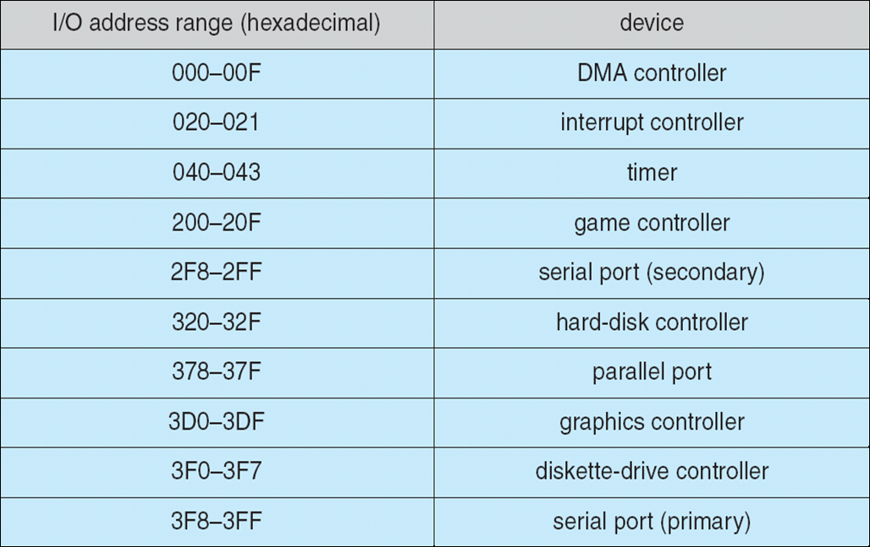
For controller, Instructions and parameters are kept in some MM region – called ports
PPTs.2012\PPTs from others\www.cs.bilkent.edu.tr_~korpe_courses_cs342spring2010\lecture13_io.ppt

Slide 12
CPU
Logic Circuit
Data 0
Data 1
Data n-1
Command

Slide 13
Executing instructions
Instructions are transferred from MM into ``command’’ register one after another
Parameters are also transferred into corresponding registers when needed
The predefined instruction could trigger related electronic circuits to carry out corresponding function
Like addition, multiplication, minus, etc.
Also read/write data from/into some device
I hope you remember these learned from CO course

Slide 14
Executing your program
To run your program, executable file should be gotten usually by compilation
Executable file contains the instructions and data you define when you do programming
Those instructions are transferred to corresponding registers in CPU/controller one after another, …
And you’ve learned how an instruction is decoded and executed
Next is to learn how your executable program is conveyed from hdisk into MM. – 2 mappings

Slide 15


Executing cooperated & concurrent programs
If there is no controlled access to shared data, execution of the processes on these data can interleave⬅ Cooperation.
The results will then depend on the order in which data were modified→ Data Inconsistency ➔ Synchronization
i.e. the results are non-deterministic.
Concurrent processes (or threads) often need to share data (maintained either in shared memory or files) and resources
If there is no proper policy to assign resources among processes, it may result in that all the processes get blocked → Deadlock [死锁]
PPTs from others\flame.cs.dal.ca_~hawkey_3120\May21ProcessSynchronization.ppt

Slide 16


Synchronization – All for lock mechanism
The general layout is of lock mechanism is: do {
acquire lock
critical section
release lock
remainder section
} while (TRUE);

Slide 17
General rules to cope with CS problem using semaphores
Find the types of actors
To determine the processes
Recognize the shared resources between actors
Infer the constraints based on the situations when actors use those shared resources
ME or SCH?
To determine semaphores and their initial values
To determine the code (nested for ME, and scattered for SCH)
Use semaphores to finish those processes

Slide 18

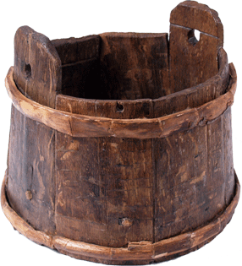
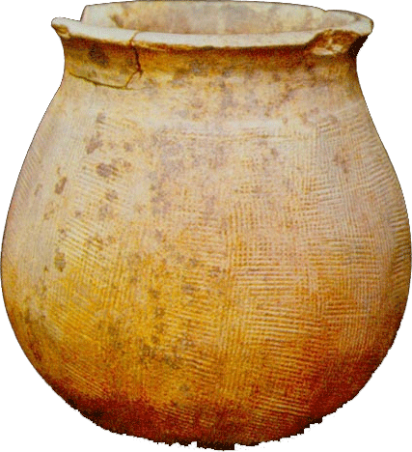



Notes:
Long ago there are many monks in a temple. Some were old and some were young. The young monks were bringing up water from a well. And the old monks can regale on it.
The well was too small to put one bucket every time.
Another vat [大桶] is in the kitchen. It can contain total 10 buckets water. Only one bucket can put in vat and fetch out water.
There are 3 buckets can be used by everyone.

Slide 19
Deadlock
Four necessary conditions
Mutual Exclusion [互斥]
Hold-and-Wait [占有并等待]
No preemption [非抢占]
Circular Wait [循环等待]
Strategies to overcome the deadlock situation
Providing enough resources
Staying Safe
Preventing Deadlocks
Avoiding Deadlocks → Banker’s algorithm!
Living Dangerously
Keep blind (Ostrich[鸵鸟] or Head-in-the-Sand algorithm)
Detect it and Recover from it.

Slide 20
Example 3:
5 processes P₀ through P₄;
3 resource types:
A (10 instances), B (5instances), and C (7 instances)
Snapshot at time T₀:
Allocation Max Available
A B C A B C A B C
P₀ 0 1 0 7 5 3 3 3 2
P₁ 2 0 0 3 2 2
P₂ 3 0 2 9 0 2
P₃ 2 1 1 2 2 2
P₄ 0 0 2 4 3 3
Could the request of P0=<2 1 1> be satisfied or not?

Slide 21
Review
Sketch of OS
Infinite repetition, 4 components, services for others
Understand the execution first
CPU and controller as special chips which could understand and execute the instructions (together with other parameters)
2 mappings share similar scheme
from logic file space (a finite collection of bytes) into linear addressed space (frames, blocks)
Organize the basic storage units first
MM & Hdisk
keep necessary data structures (together with related operations) to carry out the mappings

Slide 22
2 spaces are similar
Usually, your executable program is stored permanently in Hdisk first – 1st space
To run, it should be copied into MM – 2nd space
Hdisk and MM could be both conceived as two linear addressed spaces
Each primary storage unit is uniquely numbered.
Usually 1 byte for MM, and sector (512 bytes) for Hdisk
Those primary storage units are further organized into larger semantic regions
(Fixed or Variable) Partitions, Frames for MM
Partitions (logic drives), blocks for Hdisk

Slide 23
Basic tasks of 2 mappings
2 tasks when carrying out mappings (no matter MM or Hdisk)
Space Allocation: find enough available regions for your program
Enough available frames for MM, blocks for Hdisk
Address translation (Relationship reserving): convert the logic relationship of records into physical relationship delegated by storing records in connected physical regions
Through the physical addresses of those related regions

Slide 24
 | Mapping 1: File to MM | Mapping 2: File to Hdisk
Space Allocation | Fixed Partition Cut MM into partitions (equal or unequal) in advance Place your program into the target partition Variable partition Allocate MM according to your program Overlay DLL (Dynamic Linking Library) Paging Cut MM and program into same sized regions (frame, page) Paste needed pages into available frames Segmenting Cut program into semantic regions Allocate MM according to needed region | Sector (C.H.S) → Partitions (except MBR) → Block space Since file is usually also cut into pages whose size is same with the block, the allocation of the file into block space is similar as that of paging
Relationship Reserving | To compute physical address of an instruction is based on (starting address of the target region in MM, offset of the instruction in file) | To compute physical address of a record is based on (file handler, offset of the record in file, size of the record)

Slide 25
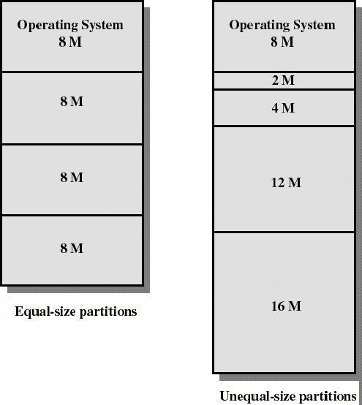
MM – partitions
Fixed – cut MM into fixed-size partitions, then put your program into corresponding partition
Some data structures are needed
Available partitions
Mapping information from programs and corresponding partitions
Placement & Replacement algorithms
Based on those data structures
Notes:
[2014-04-09] 削足适履

Slide 26
MM – partitions
Variable – cut the MM according to the size of your program
Some data structures are needed
Available partitions
Mapping information from programs and corresponding partitions
Placement & Replacement algorithms, compaction
Based on those data structures
OS
OS
OS
OS
process 5
process 5
process 5
process 5
process 9
process 9
process 8
process 10
process 2
process 2
process 2
process 2

Slide 27
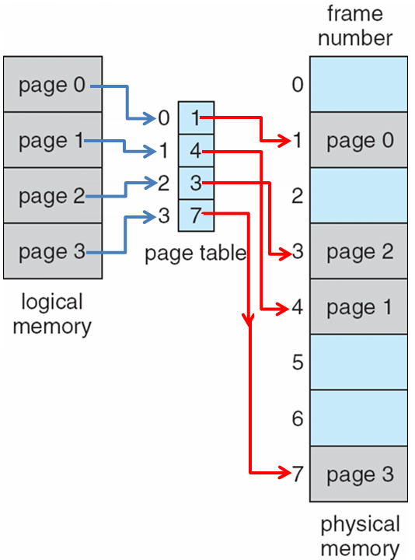
MM – paging
Paging is the extension of equal size fixed partition + swapping
Paging –
cut MM and program into same sized regions (page for program, frame for MM)
Copy pages of your program into available frames as needed
If no available frames, evacuate some frames
Some data structures are needed
Available frames,
Mapping information between your program’s pages and target frames (page table)
Placement & Replacement algorithms
Based on those data structures

Slide 28
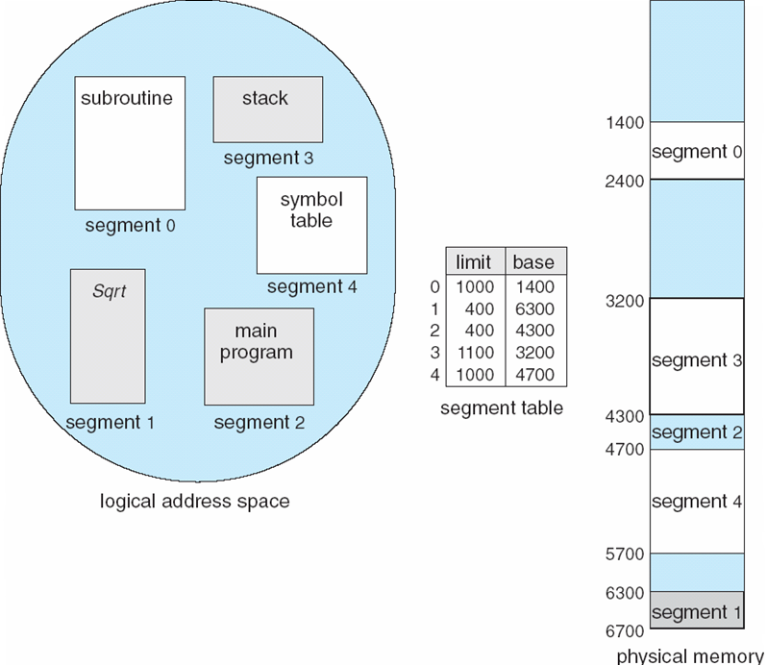
MM – segmenting
Segmenting is the extension of variable partition + swapping
Segmenting –
Cut your program into semantic regions
Copy needed segments of your program into MM
Some data structures are needed
Available MM regions,
Mapping information between your program’s segments and corresponding MM regions (segment table)
Placement & Replacement algorithms
Based on those data structures

Slide 29
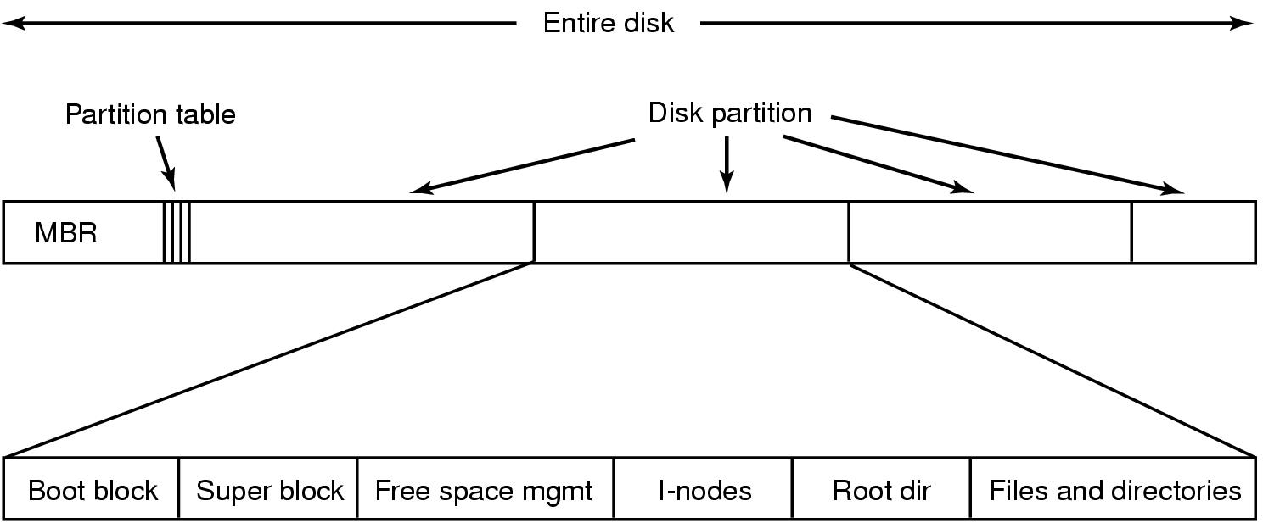
Sector → Partition → Block
Sectors are further reorganized into blocks to convenience the mapping of your file
Usually, the size of a block is 4KB – same as a page/frame
Block 0
Block 1
Block 2
Block K

Slide 30
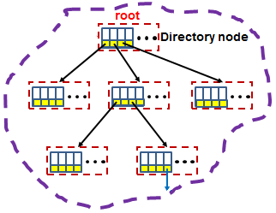
0000 1101 0110
Bitmap
Blocks for files
and directories
Disk → Partitions → Blocks → FS

Slide 31
Review
Sketch of OS
Infinite repetition, 4 components, services for others
Understand the execution first
CPU and controller as special chips which could understand and execute the instructions (together with other parameters)
2 mappings share similar scheme
from logic file space (a finite collection of bytes) into linear addressed space (frames, blocks)
Organize the basic storage units first
keep necessary data structures (together with related operations) to carry out the mappings

Slide 32
Data structures are needed to carry out those related tasks
Available regions
Available partitions for partitioning, Available frames for paging/hybrid, available holes for segmenting, …
Organize sectors into semantic regions first, and Bit-vector, FAT for Hdisk, …
Mapping information from file to target physical regions
Partition table, Page table, Segment table, …
Tree-structured directories + FCBs as File System for Hdisk, …

Slide 33
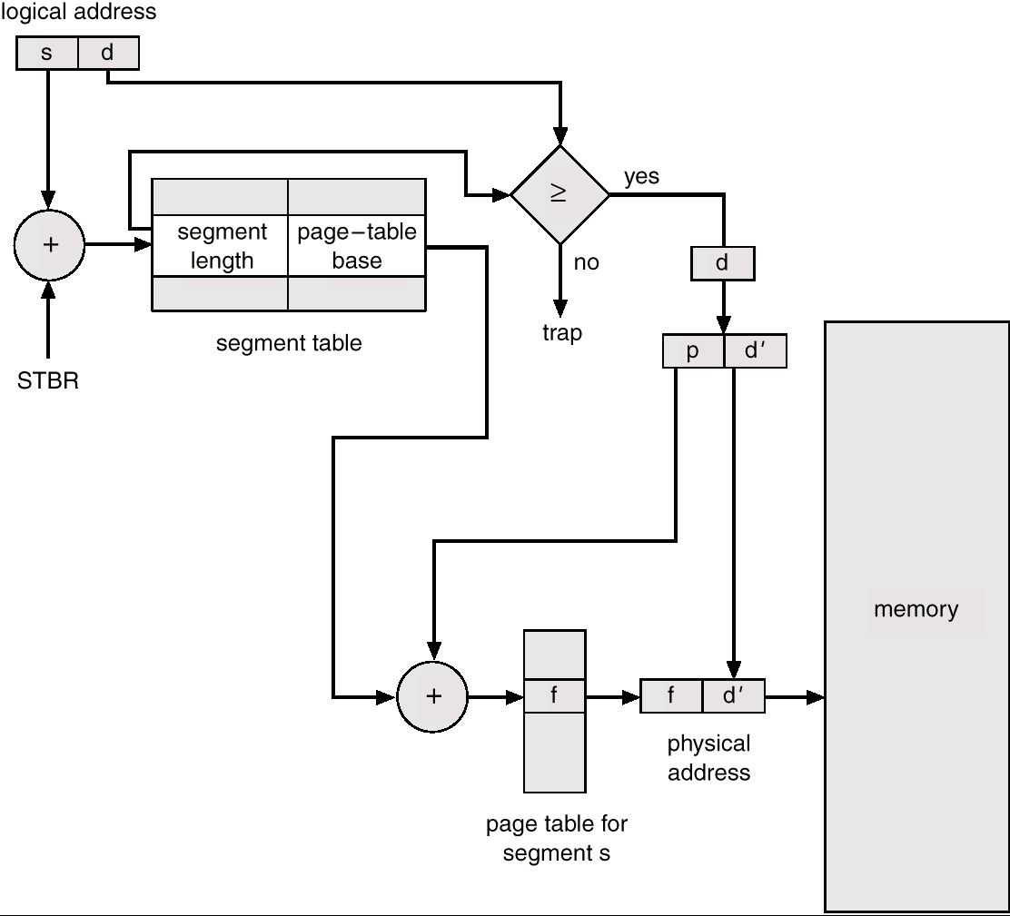
MM – hybrid
Segmenting + Paging
Only segmenting may not practical: we should also consider the size of the segments
Cut MM into frames, program into segments first, and segment is further cut into pages (if necessary)
Some data structures are needed
Available frames,
Mapping information between your and corresponding frames (segment/page table)
Placement & Replacement algorithms
Based on those data structures

Slide 34
File System Implementation
Major On-disk Structures (information):
Boot control block contains info needed by system to boot OS from that volume
Volume control block contains volume details
Directory structure organizes the files
Per-file File Control Block (FCB) contains many details about the file
info about a file and its location on disk
partition (volume) starts
Pointers to FCBs
Boot
Control
Block
Volume
Control
Block
Directory
Structure
File Control Blocks
(FCBs)
(filename to FCB mapping)
(i.e. superblock)

Slide 35
Layered Software
Processes
read file f, write file f, ..
(operation will be offset p, n bytes)
File System Calls
File System
find file info for f
(f, p, n) → disk block numbers
Kernel
Mode
Software
write disk block x, ..
read disk block x, …
Disk Driver
[cylinder#, track#, sector#],
operation code: R,W
Disk Controller
Hardware
Disk
cylinders, tracks, sectors
Notes:
Zh 4-28

Slide 36
 | Execution | 2 mappings
Data structures | PCB (TCB) Queues – PCBs are transferred among queues | All are linear addressed space – file, MM, Hdisk Available regions partitions, frames for MM Bit-vector, FAT for Hdisk Mapping information Partition/Page/Segment table for MM Tree structured directories + FCBs as FS (File System) for Hdisk
Algorithms | Process related operations Creation, Termination, … Process switching Process schedulers – CPU scheduling algorithms Synchronization Deadlock | To carry out the mappings Placement & Replacement algorithms, Compaction for MM File related operations for Hdisk Create, delete, append, …

